Slide 2
explore concepts of distribution models
learn types of distribution data

Slide 3
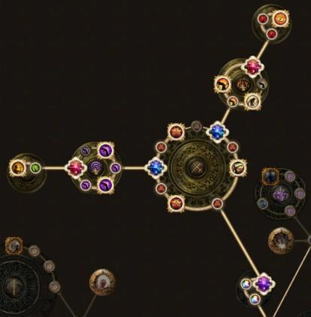
Distribution Models
Run databases on a large cluster

Slide 4
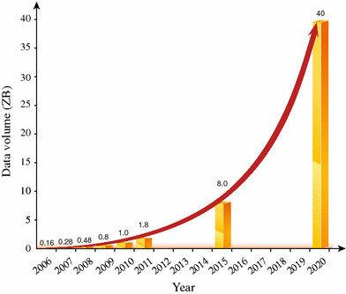
Distribution Models
Run databases on a large cluster
As data volumes increase

Slide 5

Distribution Models
Bigger server to run the database

Slide 6
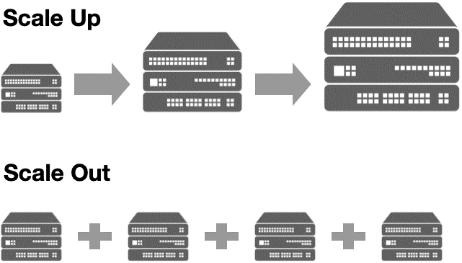

Distribution Models
A more appealing option is

Slide 7
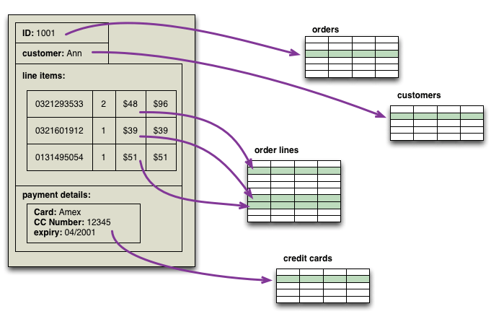
Distribution Models
Aggregate orientation fits well with scaling out

Slide 8

Distribution Models
Important Benefits of Distribution Model
Handle larger quantities of data

Slide 9
Distribution Models
IMPORTANT BENEFITS OF DISTRIBUTION MODEL
Handle larger quantities of data
Process a greater read or write traffic

Slide 10

Distribution Models
Network slowdowns or breakages

Slide 11

Distribution Models
These are often important benefits, but they come at a cost. Running over a cluster introduces complexity - so it’s not something to do unless the benefits are convincing.

Slide 12
Two styles of distributing data
There are two styles of distributing data:
Sharding:
Replication
Master –slave
Peer-to-peer

Slide 13
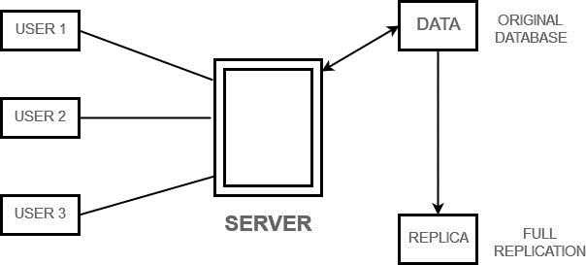
Two styles of distributing data
REPLICATION

Slide 14
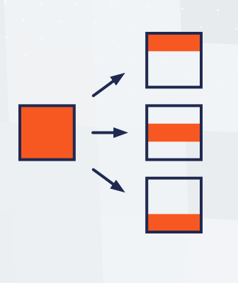
Two styles of distributing data
Sharding

Slide 15
Single Server

Slide 16
Single Server
No distribution at all.
Run the database on a single.
It eliminates all the complexities that the other options introduce
Easy for operations people to manage
Easy for application developers to reason about.

Slide 17
Single Server
Ques: Which database works best in single-server configuration ?

Slide 18
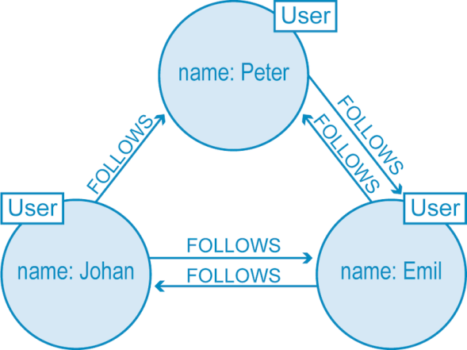
Single Server
Ques: Which database works best in single-server configuration ?
Graph Database

Slide 19
Single Server
What is the most appropriate solution for processing aggregates in a single-server document?

Slide 20
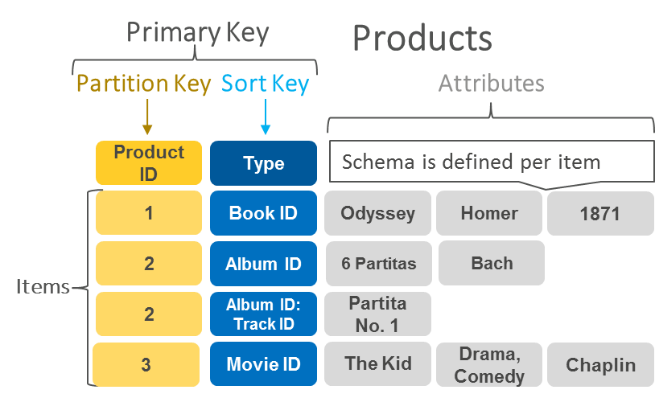
Single Server
Key-value store

Slide 21
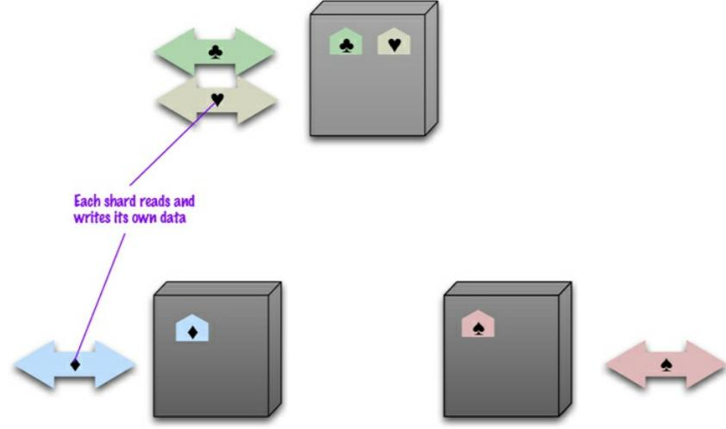
Sharding

Slide 22
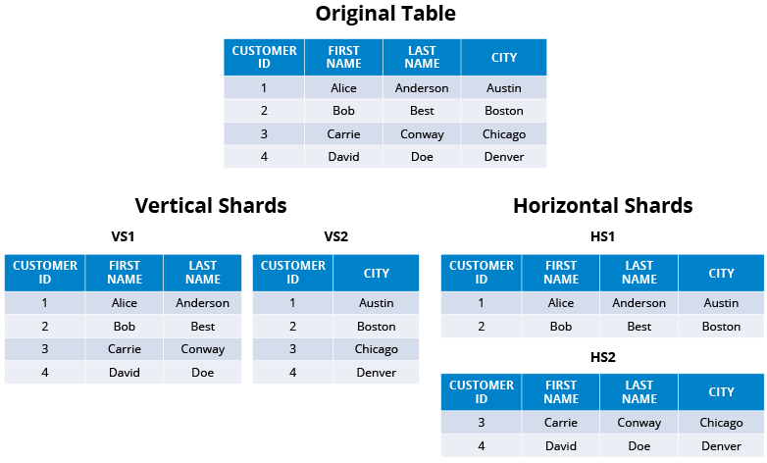
Sharding

Slide 23
Why Is Sharding Used?
Rapid responses from that server.
The load is balanced out nicely between servers.
You can store the new chunks of data, called logical shards
Can take advantage of all the compute resources across your cluster for every query.
Scan fewer rows when responding to a query.

Slide 24
Why Is Sharding Used?
Rapid responses from that server.
The load is balanced out nicely between servers.
You can store the new chunks of data, called logical shards
Can take advantage of all the compute resources across your cluster for every query.
Scan fewer rows when responding to a query.

Slide 25
Why Is Sharding Used?
Rapid responses from that server.
The load is balanced out nicely between servers.
You can store the new chunks of data, called logical shards
Can take advantage of all the compute resources across your cluster for every query.
Scan fewer rows when responding to a query.

Slide 26
Why Is Sharding Used?
Rapid responses from that server.
The load is balanced out nicely between servers.
You can store the new chunks of data, called logical shards
Can take advantage of all the compute resources across your cluster for every query.
Scan fewer rows when responding to a query.

Slide 27
Why Is Sharding Used?
Rapid responses from that server.
The load is balanced out nicely between servers.
You can store the new chunks of data, called logical shards
Can take advantage of all the compute resources across your cluster for every query.
Scan fewer rows when responding to a query.

Slide 28
Sharding
How to clump the data up so that one user mostly gets her data from a single server ?

Slide 29
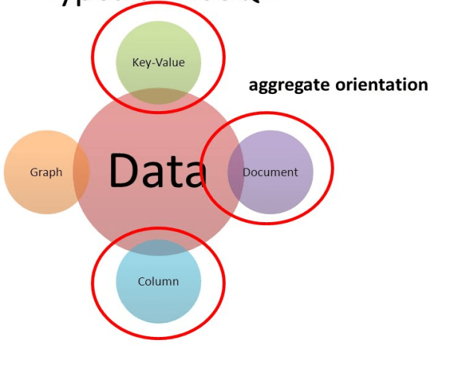
Sharding
How to clump the data up so that one user mostly gets her data from a single server

Slide 30
Sharding
Combine data that’s commonly accessed together.
There are several factors that can help improve performance.

Slide 31
Sharding
Combine data that’s commonly accessed together.
There are several factors that can help improve performance.

Slide 32
Sharding
Place the data close to where it’s being accessed.
If you have orders for someone who lives in Boston, you can place that data in your eastern US data center

Slide 33
Sharding
Place the data close to where it’s being accessed.
If you have orders for someone who lives in Boston, you can place that data in your eastern US data center

Slide 34
Sharding
To keep the load even
Puts Aggregate together
Keeping its rows in lexicographic order.
sorting web addresses based on reversed domain names

Slide 35
Sharding
To keep the load even
Puts Aggregate together
Keeping its rows in lexicographic order.
sorting web addresses based on reversed domain names

Slide 36
Sharding
To keep the load even
Puts Aggregate together
Keeping its rows in lexicographic order.
sorting web addresses based on reversed domain names

Slide 37
Sharding
To keep the load even
Puts Aggregate together
Keeping its rows in lexicographic order.
Sorting web addresses based on reversed domain names

Slide 38
Sharding
Historically most people have done sharding as part of application logic
A to D
E to G

Slide 39
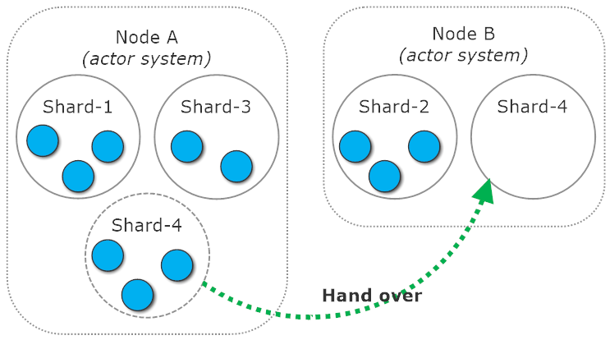
Sharding
Rebalancing the Sharding

Slide 40
Sharding
Rebalancing the Sharding
Changing the application code.
Migrating the data.

Slide 41
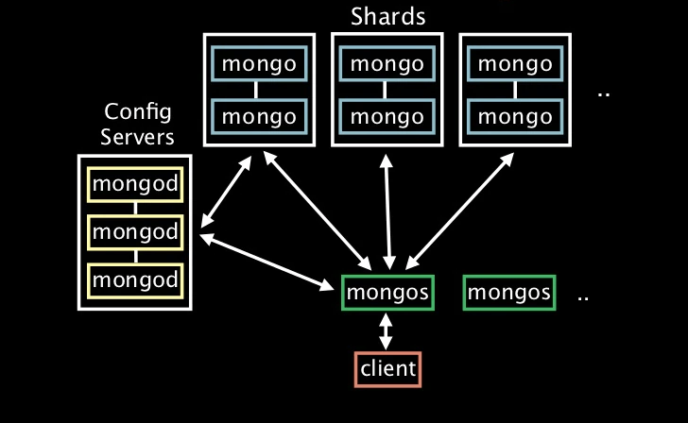
Auto-Sharding
Auto-sharding Shards mongo mongo mongo

Slide 42
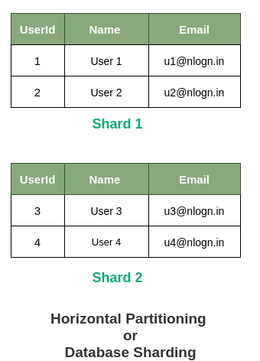
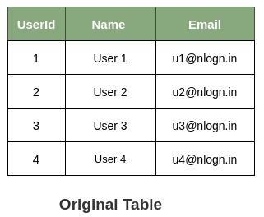
When Horizontal Sharding is Effective?

Slide 43
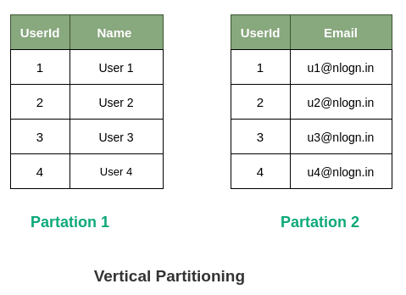
When Vertical Sharding is Effective?

Slide 44
Sharding
Sharding is particularly valuable for performance.
Using replication, particularly with caching, can greatly improve read performance.
Sharding provides a way to horizontally scale writes.

Slide 45
Sharding
Improve resilience when used alone.
Although the data is on different nodes, a node failure makes that shard’s data unavailable just as surely as it does for a single-server solution.

Slide 46
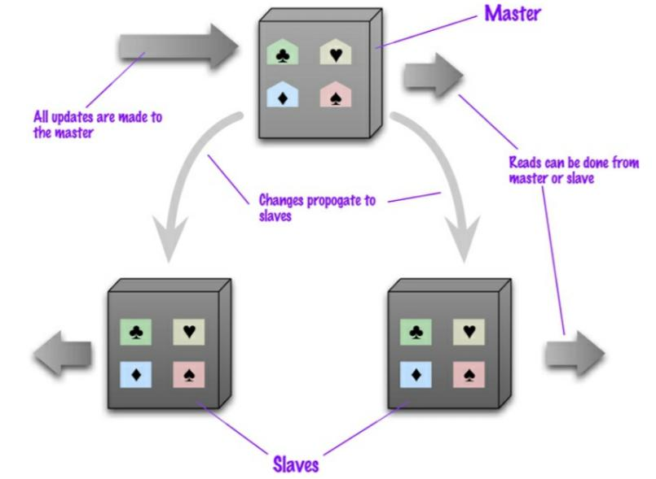
Master-Slave Replication
Data is replicated from master to slaves. The master services all writes; reads may come from either master or slaves.

Slide 47
Master-Slave Replication
Master-slave replication is most helpful for scaling when you have a read-intensive dataset.
You can scale horizontally to handle more read requests by adding more slave nodes and ensuring that all read requests are routed to the slaves.

Slide 48
Master-Slave Replication
You are still, however, limited by the ability of the master to process updates and its ability to pass those updates on.
Consequently it isn’t such a good scheme for datasets with heavy write traffic, although offloading the read traffic will help a bit with handling the write load.

Slide 49
Master-Slave Replication
A second advantage of master-slave replication is read resilience:
The failure of the master does eliminate the ability to handle writes until either the master is restored or a new master is appointed.

Slide 50
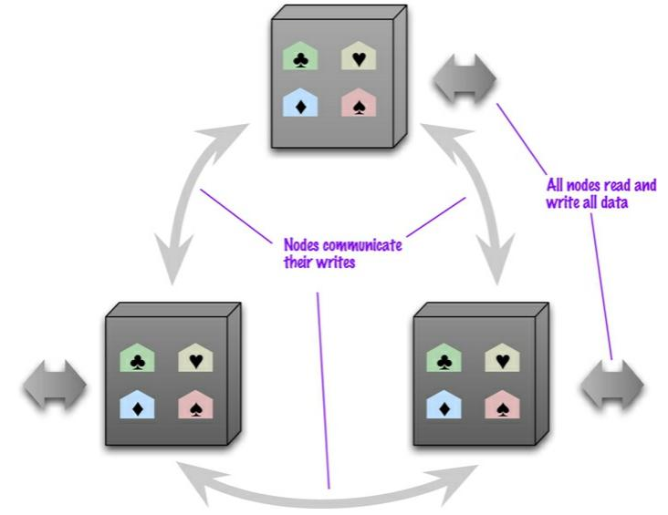
Peer-to-Peer Replication

Slide 51
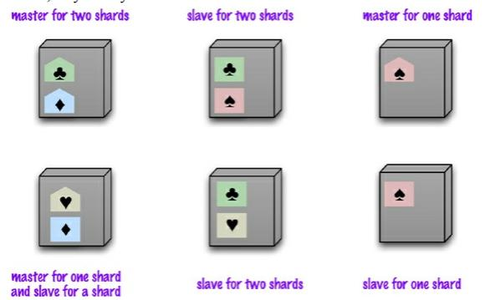
Combining Sharding and Replication
Using master-slave replication together with sharding

Slide 52
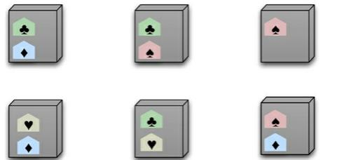
Combining Sharding and Replication
Using peer-to-peer replication together with sharding

Slide 53
What Is the Difference between Sharding and Partitioning?
breaking up a large data set into smaller subsets.
sharding implies the data is spread across multiple computers while partitioning does not.
Partitioning is about grouping subsets of data within a single database instance.
In many cases, the terms sharding and partitioning are even used synonymously.

Slide 54
What Is the Difference between Sharding and Partitioning?
breaking up a large data set into smaller subsets.
sharding implies the data is spread across multiple computers while partitioning does not.
Partitioning is about grouping subsets of data within a single database instance.
In many cases, the terms sharding and partitioning are even used synonymously.

Slide 55
What Is the Difference between Sharding and Partitioning?
breaking up a large data set into smaller subsets.
sharding implies the data is spread across multiple computers while partitioning does not.
Partitioning is about grouping subsets of data within a single database instance.
In many cases, the terms sharding and partitioning are even used synonymously.

Slide 56
What Is the Difference between Sharding and Partitioning?
breaking up a large data set into smaller subsets.
sharding implies the data is spread across multiple computers while partitioning does not.
Partitioning is about grouping subsets of data within a single database instance.
In many cases, the terms sharding and partitioning are even used synonymously.

